Slide 1
HEART ATTACK PREDICTION
Objective : To Predict whether a patient will have a Heart Attack or not.
Software used: Anaconda, Jupyter notebook, VS CODE
Algorithm used: RANDOM FOREST ALGORITHM
Data Preprocessing Techniques:
Standard Scalar for getting better Accuracy

Slide 2
How to:
Read the csv file using pandas read_csv() function.
Apply different Data preprocessing technique to fill the data with fillna().
Divide data set into input and output; input having independents value
and output having dependent variables.
Further dividing x and y into x_test, x_train and y_test, y_train respectively using train_test_split().
Importing and applying Logistic Regression model from sklearn.
Predict the result giving all independent values as input to the model.

Slide 3
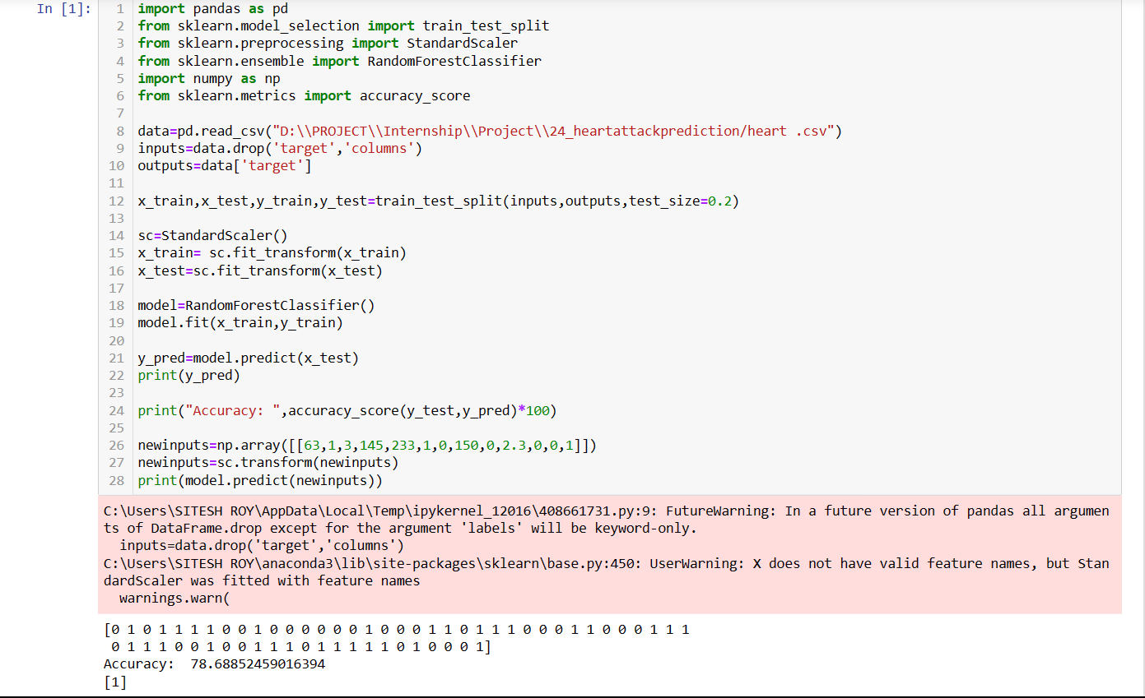
Codes:

Slide 4
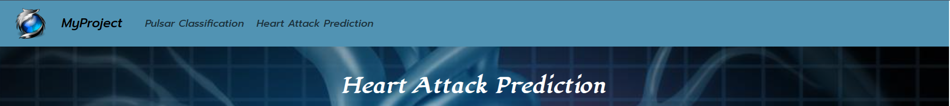
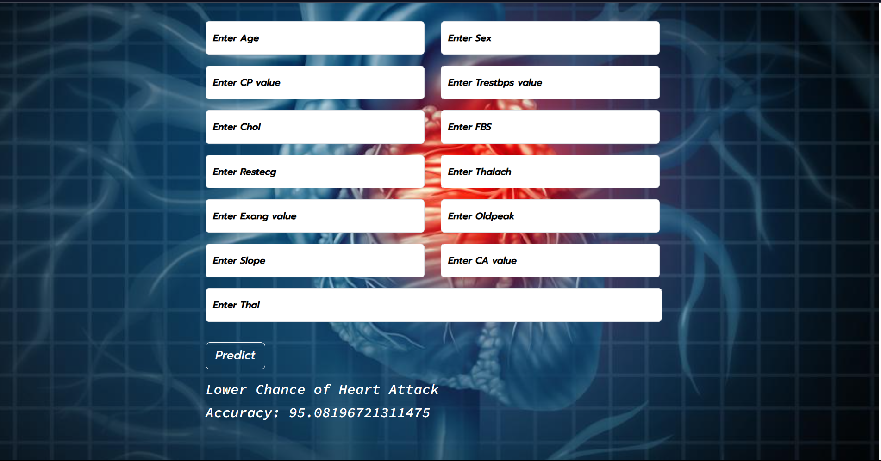
output:

Slide 5
End of presentation
Thank you . . .

